Slide 1
Intelligent Food Nutrient Analysis
BCSE309L
Artificial Intelligence
Libin Alex - 21BCE5845

Slide 2
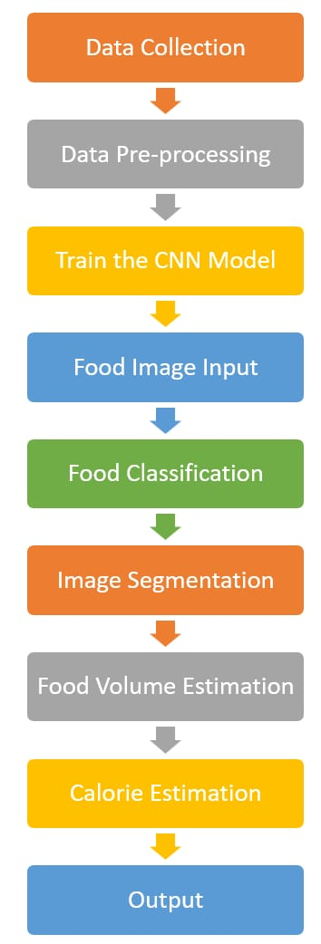
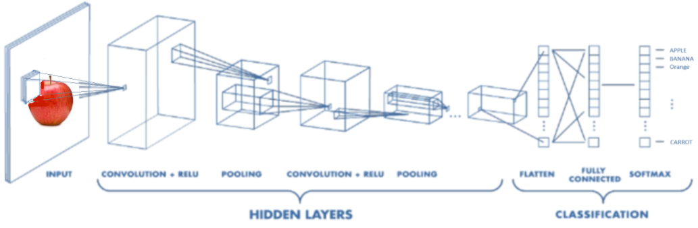
Methodology
Flow diagram

Slide 3
Methodology
Two major objectives:
To detect food type by using Convolutional Neural Network (CNN)
To estimate weight and thus calories of food
1. Food type recognition using CNN
A large dataset of food items is pre-processed(resizing, cropping, normalization, augmentation and removing noise) and labelled.
Model the architecture for image recognition using Convolution layers( to extract features from the image, such as edges, shapes, and textures), Pooling layers and Fully connected layers.
Train the model on the pre-processed dataset and evaluate the metrics.

Slide 4
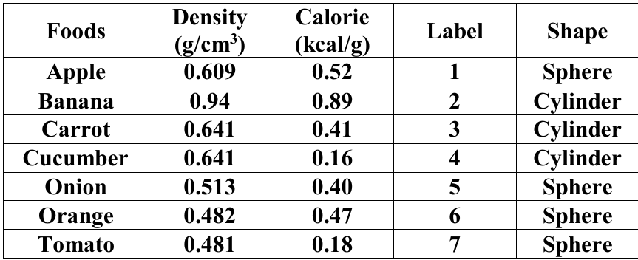
Methodology
2. Estimation of weight and calorie
For this process, we used a mixture of image processing techniques to first segment the food item to obtain the contour of the food and thumb and thus calculate their pixel area.
We use the thumb finger for calibration purposes. The thumb is placed next to the dish while clicking the photo and this thumb gives us the estimate of the real-life size of the food item and helps estimate volume accurately.
We already know area of thumb, which is 5x2.3 cm². So area per pixel is actual thumb area divided by pixel area of thumb.
From this actual food area can be calculated as: pixel area of food * area per pixel.
Once we calculate the actual food area, we estimate it’s volume assuming it to be either spherical or cylindrical in shape.
From the table we know food density (g/cm3) and food calories (kcal/g), using this information we can estimate weight and calories intake in given food.
Notes:
Density = Mass / Volume

Slide 5
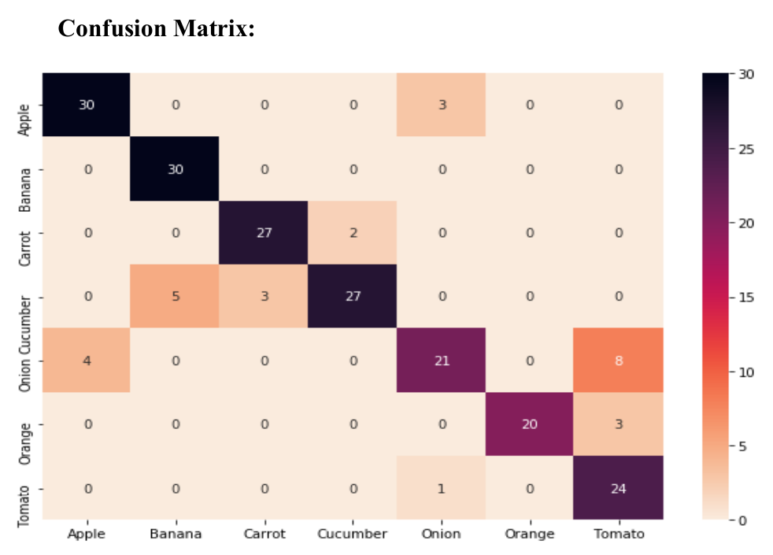
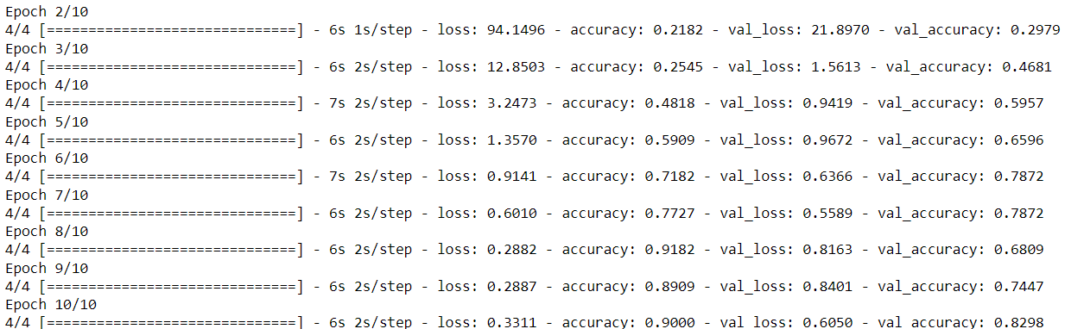
Results and Conclusion
Food Recognition
On training the model we got an accuracy of 82.92% with total loss 0.605
From confusion matrix we see that most of fruits are classified correctly

Slide 6
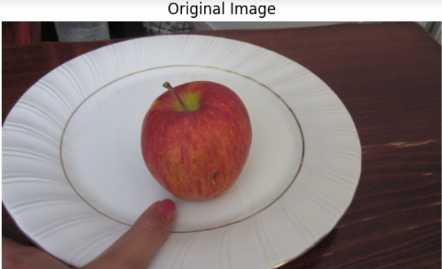
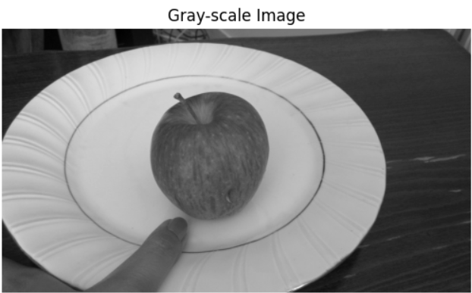
Food Segmentation
Input image
Convert to grey scale to Reduce Complexity and Focus on Contents

Slide 7
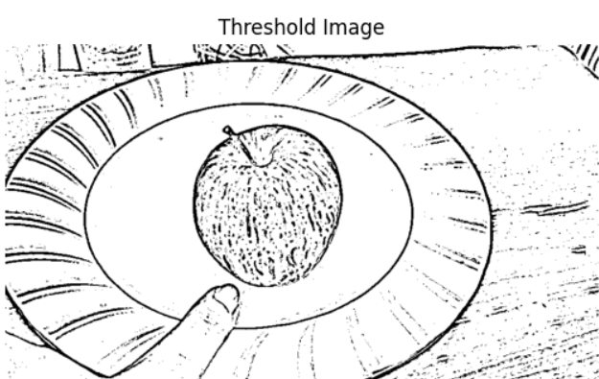
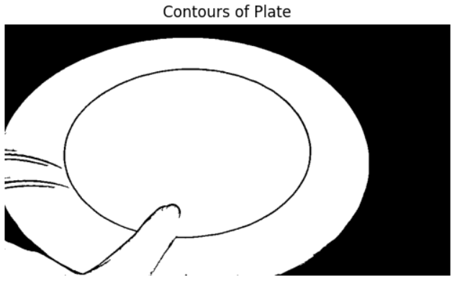
Thresholding to create a binary image
Mask of the largest contour in the image

Slide 8
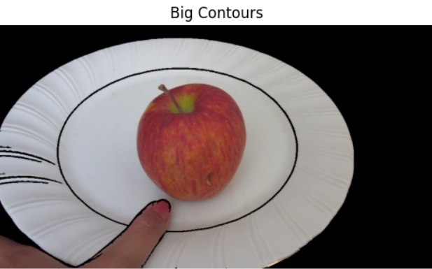
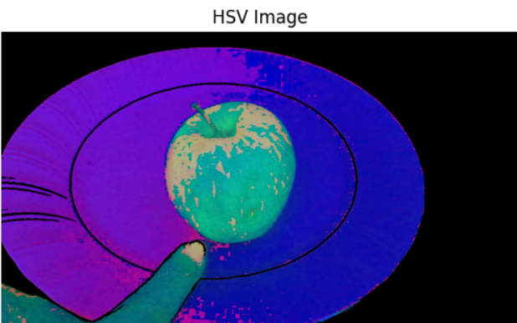
Isolate the largest item in the image.
Convert the isolated food image to HSV for color segmentation
Notes:
In HSV, Hue represents the actual color (e.g., red, green, blue), Saturation represents the color intensity (0 for gray, 255 for fully saturated), and Value represents the brightness (0 for black, 255 for white).

Slide 9
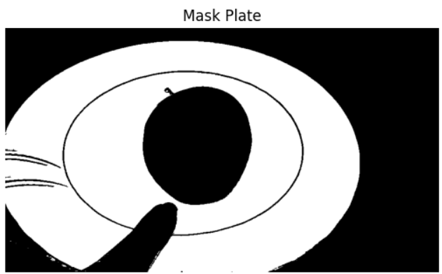
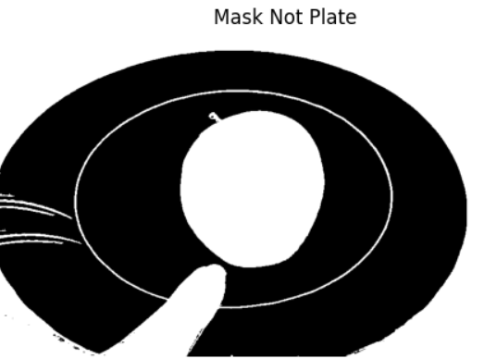
Isolate the plate region
Inverse mask of the plate region
Notes:
Create a mask where pixels that fall within a certain range of Hue (any), low Saturation (potentially plate colors), and any Value (brightness) are considered part of the plate and marked as white in the mask. The rest of the image is marked as black.

Slide 10
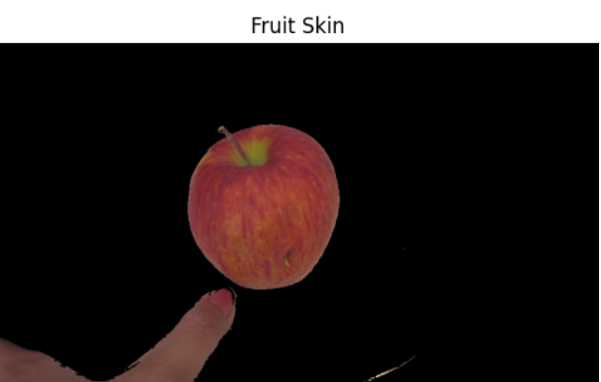
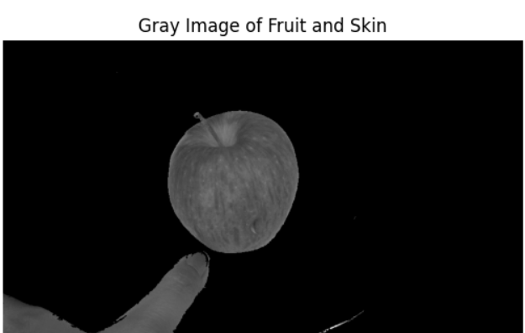
Isolate the thumb and food
Convert to Grayscale images to emphasize the shapes and textures

Slide 11
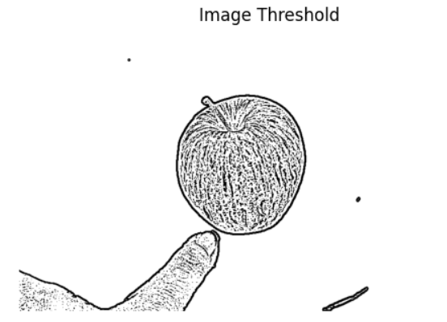
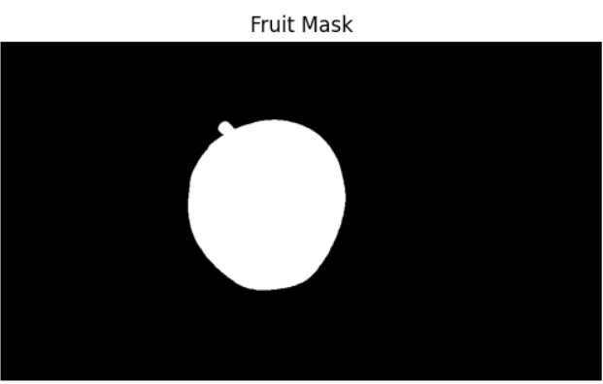
Convert to binary image
Finding contour of food and Creating a mask

Slide 12
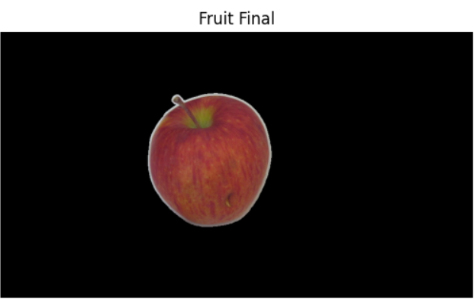
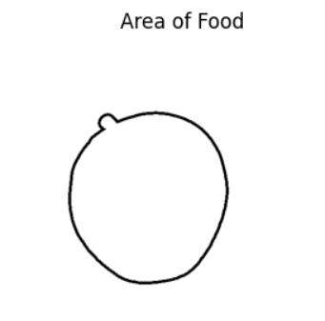
Isolated food region
Analyzing the final isolated fruit region and calculating its area

Slide 13
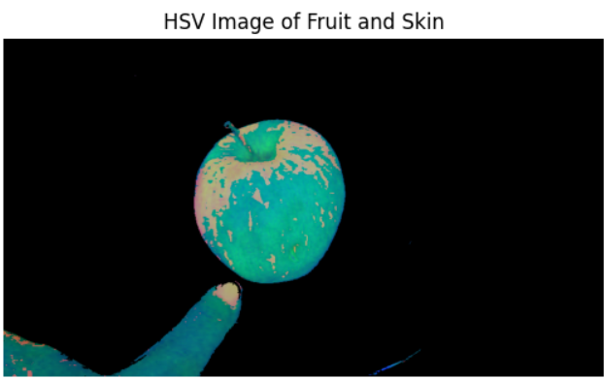
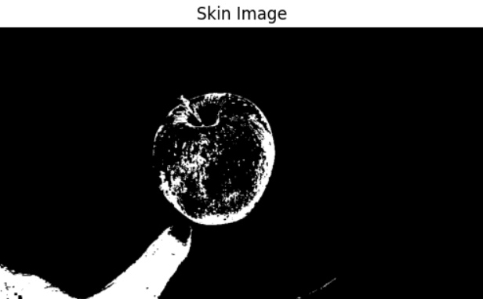
Convert to HSV colour space
Perform colour-based segmentation to highlight thumb
Notes:
Create a new image (skin) where each pixel will be set to white (255) if the corresponding pixel in the hsv_img falls within the specified range of Hue (0-10), Saturation (10-160), and Value (60-255) in the HSV color space. All other pixels will be set to black (0).

Slide 14
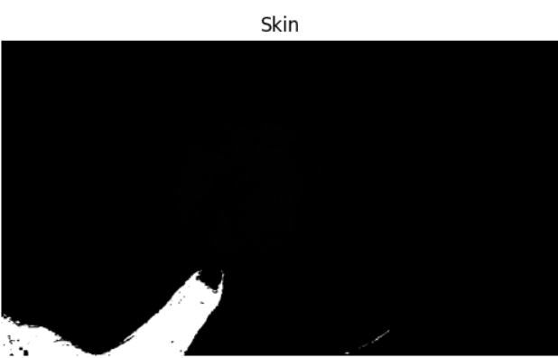
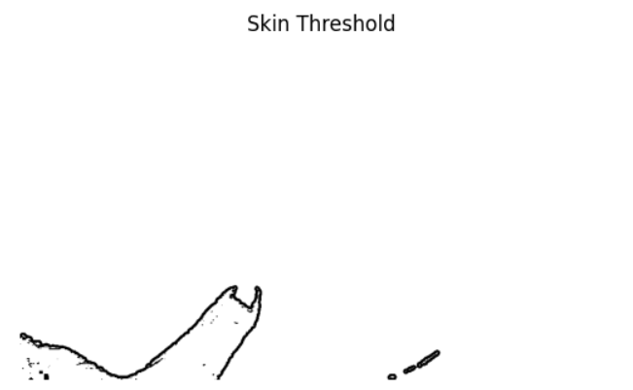
Isolate the thumb region in the image
Separate the thumb from the remaining image

Slide 15
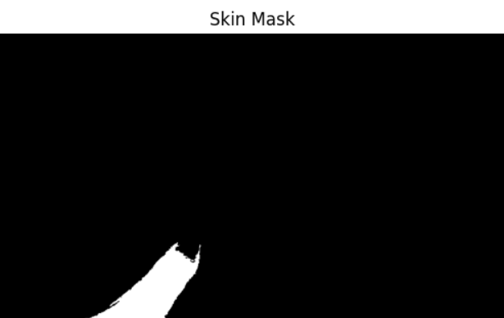
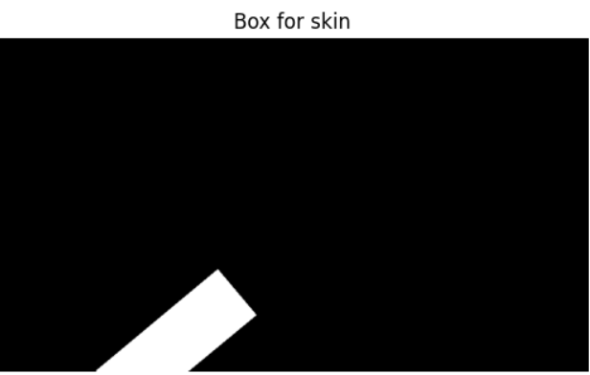
Creating a mask for the thumb
Minimum area rectangle that encloses the thumb

Slide 16
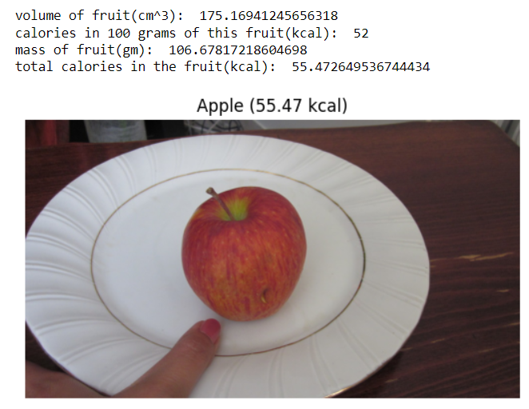
Result and Conclusion
Thus after calculating the pixel area of food item and thumb, we calculate the actual food area and thus its volume and mass to estimate the Calorie intake of given food item.
In this way, we have successfully estimated the calorie contents of a given food item using various Image Processing techniques.
Notes:
Calculate pixel to cm multiplier by using maximum pixel height
pix_to_cm_multiplier = 5.0 / pix_height
We know our thumb size is approximately 5*2.3cm -> Actual Skin area
Estimated Food Area = Foods Pixel Area ∗ Actual Skin Area / Skin Pixel Area
Estimated Weight = Actual Density ∗ Estimated Volume
Estimated Calories = Estimated Weight ∗ Calories Per 100 gm / 100

Slide 17
Thank you

